Slide 1
Bizloan Sales Buddy App

Slide 2
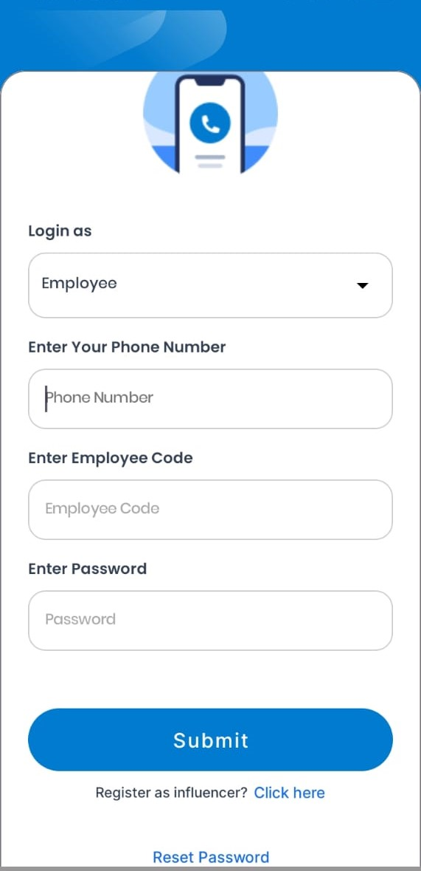
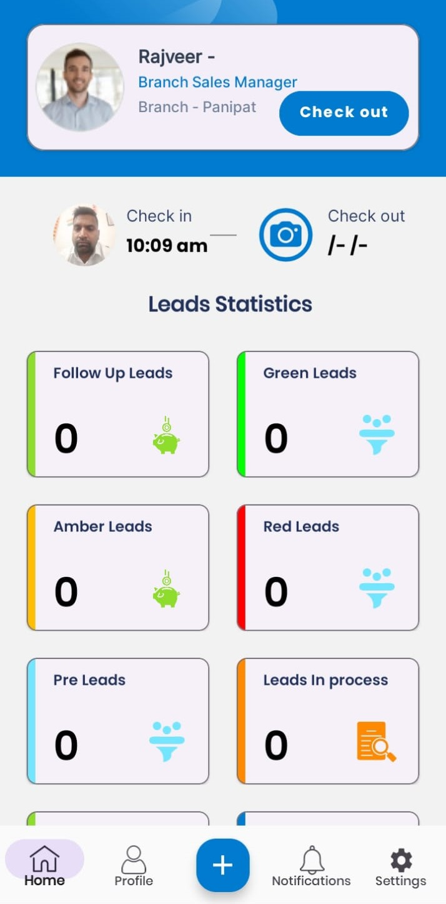
Check in Process
All employees, including RM, BM, and senior executives, use the same login process.
Steps to Login:
  Select "Login as Employee".
  Enter the registered phone number.
  Enter the employee code.
  Enter the password.
Note: Employee login credentials (e.g., for RM, BM, etc.) are created by the backend team through the admin panel.
Mandatory Check-In After successful login, every employee (RM, BM, etc.) must complete a check-in before working on the app.
The check-in process involves:
Capturing a photo.
It will record the employee’s current latitude and longitude automatically.

Slide 3
BM Role

Slide 4
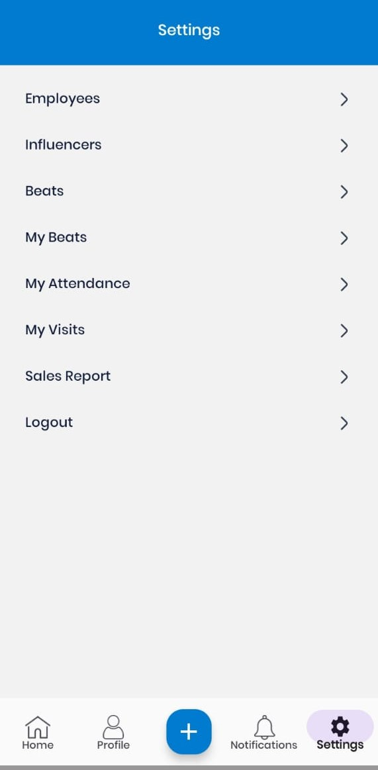
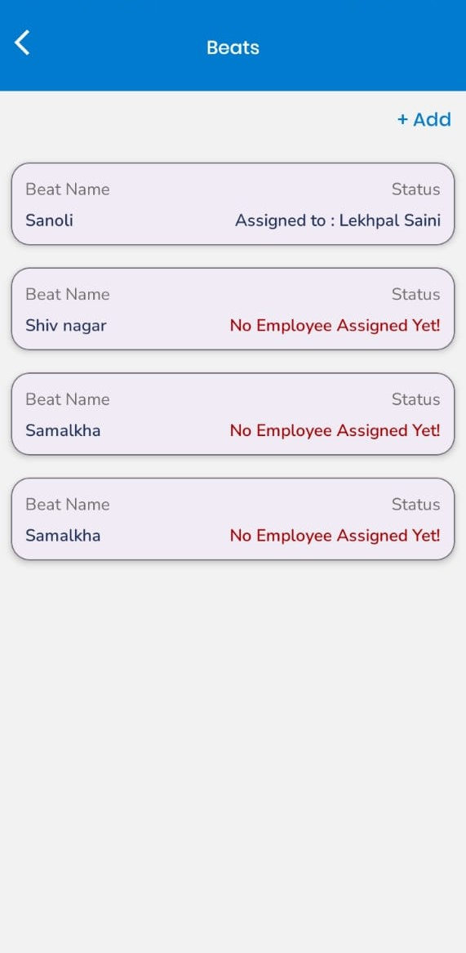
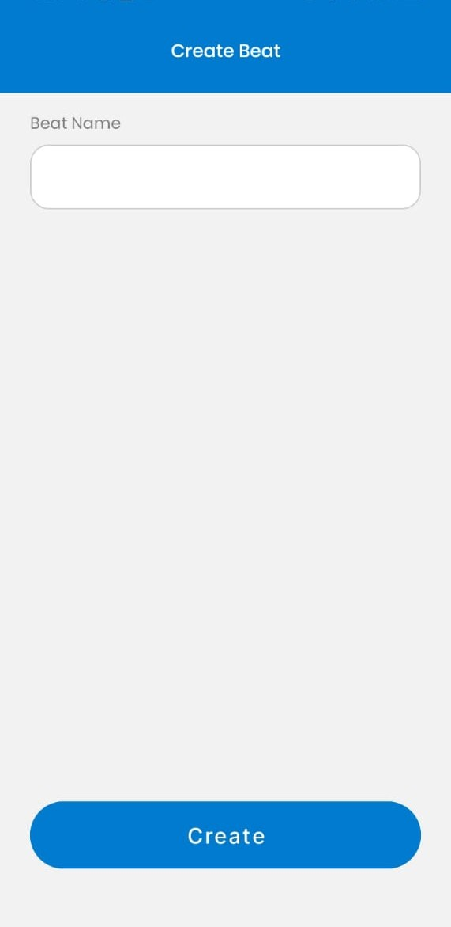
Steps to Create Beat
BM Responsibilities:
1.Create a Beat
2. Assign a Created Beat to RM
After completing the check-in, go to Settings.
Navigate to the Beat section.
To add a new beat, click on the “+ Add" button.
Enter the “Beat Name” to create a new beat.
In the Beat section, view all existing beats.

Slide 5
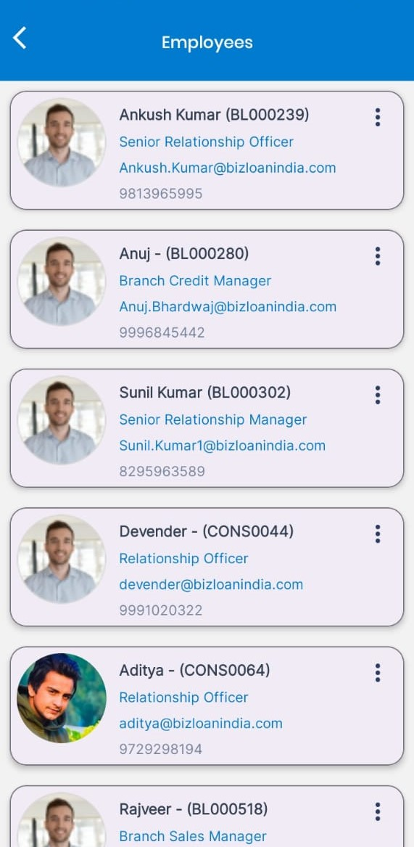
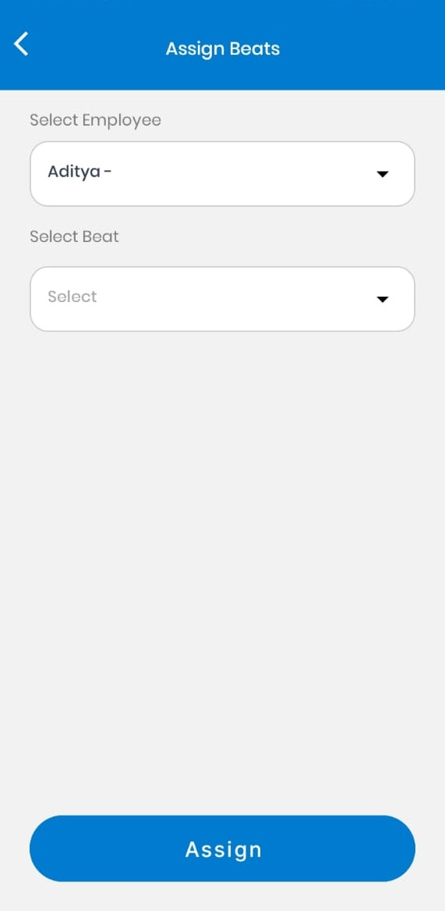
Steps to Assign Beat
After creating a beat, go to the Employee section in Settings.
Select the RM to whom you want to assign the beat.
Click on the "Assign Beat" button.
Choose the desired beat from the list and assign it.

Slide 6
RM Role

Slide 7
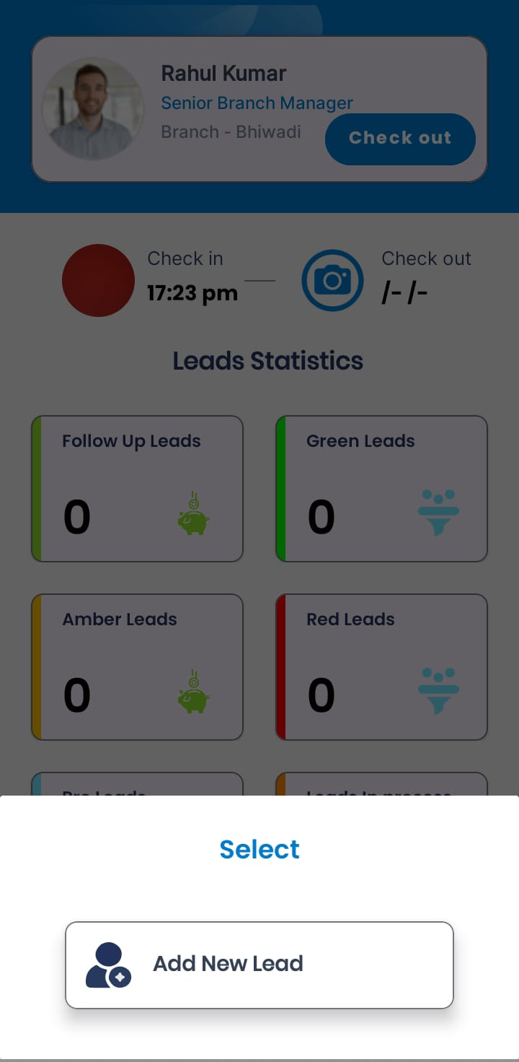
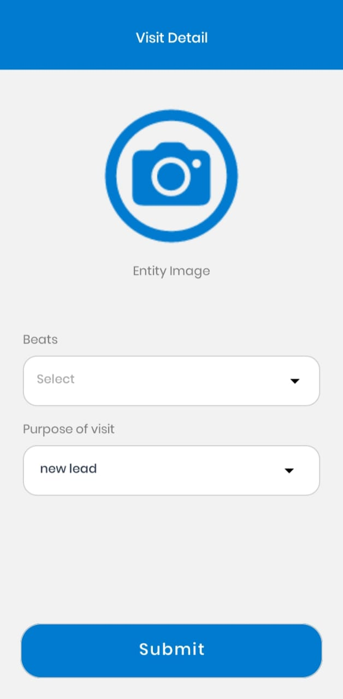
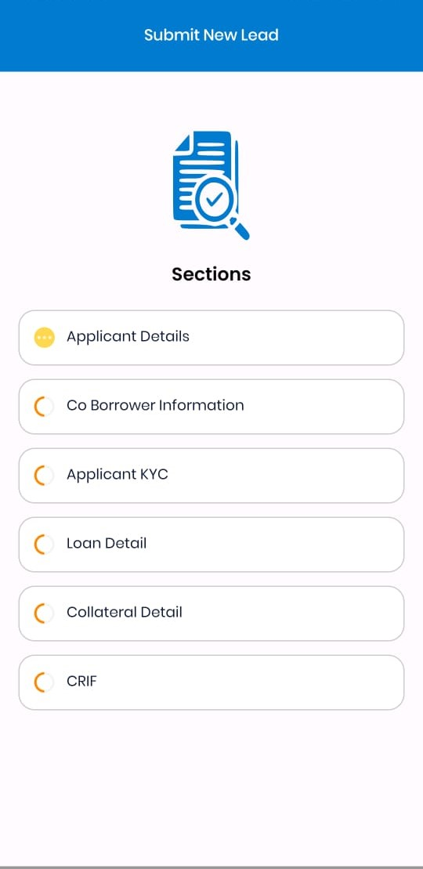
Steps to Create New Lead
Initiate Lead Creation:
Click on the "+" button located on the Dashboard screen.
Select "Add New Lead".
RM need to fill in the following details:
i) Applicant Details
ii) Co-borrower Information
iii) Applicant KYC
iv) Loan Details
v) Collateral Details
vi) CRIF Information
Upload Image: Click on the image placeholder and upload a mandatory image.
Select Assigned Beat: Choose the beat assigned to the RM by the BM.
Submit Form: Click on Submit to proceed.

Slide 8
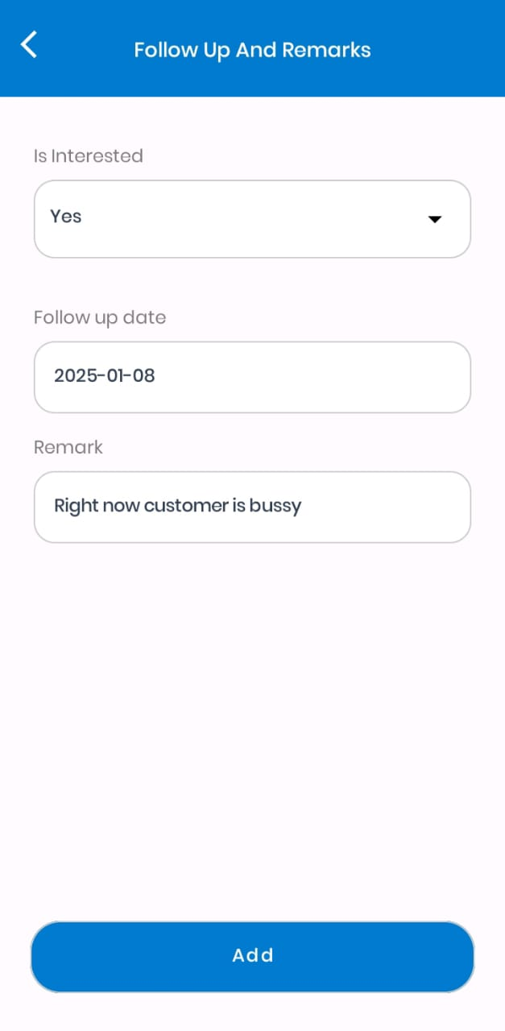
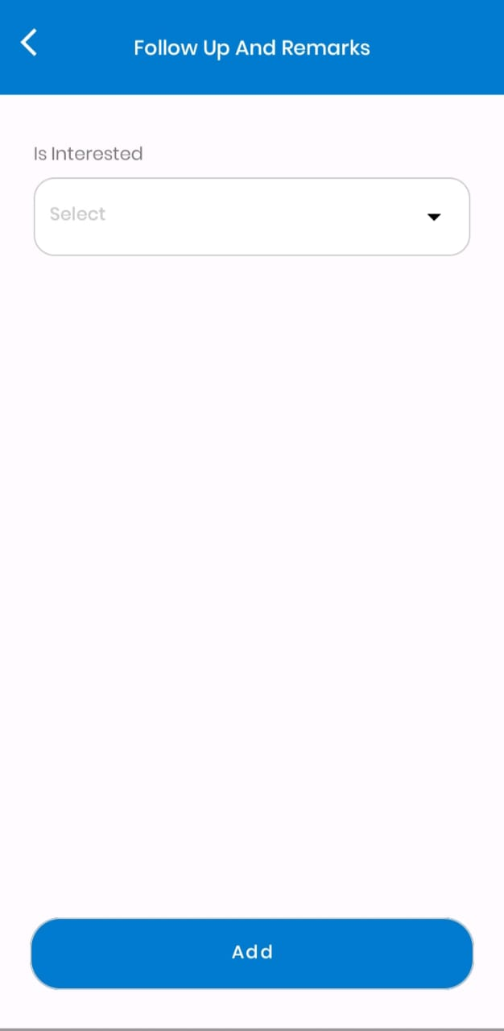
Interested and Not-Interested Leads
Scenario 1: Customer is Busy or Insufficient Information
If the customer is busy or the RM cannot gather enough relevant information to create a complete lead, they can click on "Previous". This action will display the Interested/Not Interested section.
Selecting Lead Interest:
The RM will be prompted to select an option from the dropdown: Interested or Not Interested.
Case 1: Not Interested Leads
If the customer is not interested at the moment, the RM can select Not Interested.
Even in this scenario, if some relevant information about the lead is available, it can be saved as a Pre-Lead.
A Pre-Lead indicates potential for future follow-up and conversion into a full lead.
Case 2: Interested Leads
If the customer shows interest but requests follow-up at a later date, the RM should select Interested.
The RM must then specify a Follow-Up Date for that lead.
The lead will be saved under the Follow-Up Leads section for further action.

Slide 9
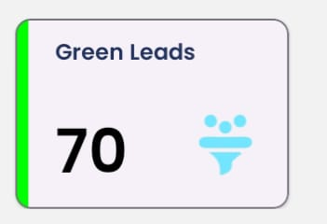
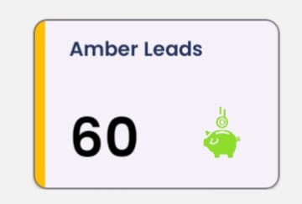
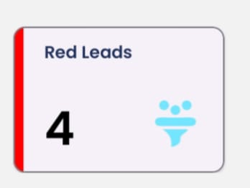
On Submission
On Submission
Lead Completion:
Once the lead is fully created, including successful generation of KYC and CRIF for the borrower and co-borrower, the lead is categorized based on the CRIF score.
Lead Categorization:
The lead is classified into Green, Amber, or Red categories according to the CRIF scores of both the borrower and co-borrower.
Green Lead:
Represents customers who are fully eligible based on their CRIF score.
CRIF Score: ≥ 700
Amber Lead:
Represents customers with potential eligibility, but their CRIF score is slightly lower.
CRIF Score: ≥ 550 but < 700
Red Lead:
Represents customers with a very low CRIF score but who may still be considered for potential cases.
CRIF Score: < 550

Slide 10
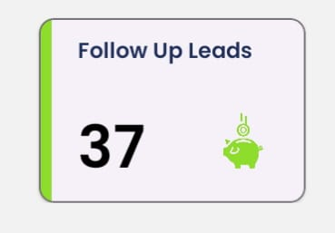
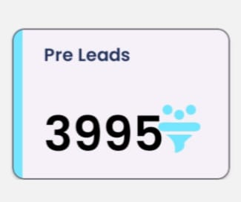
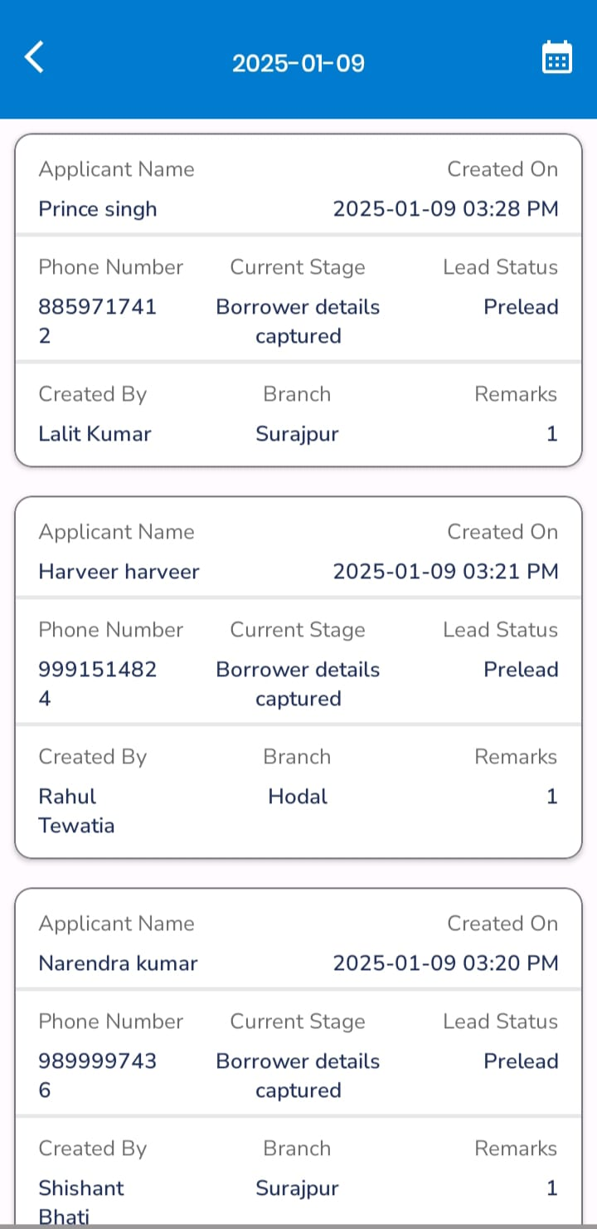
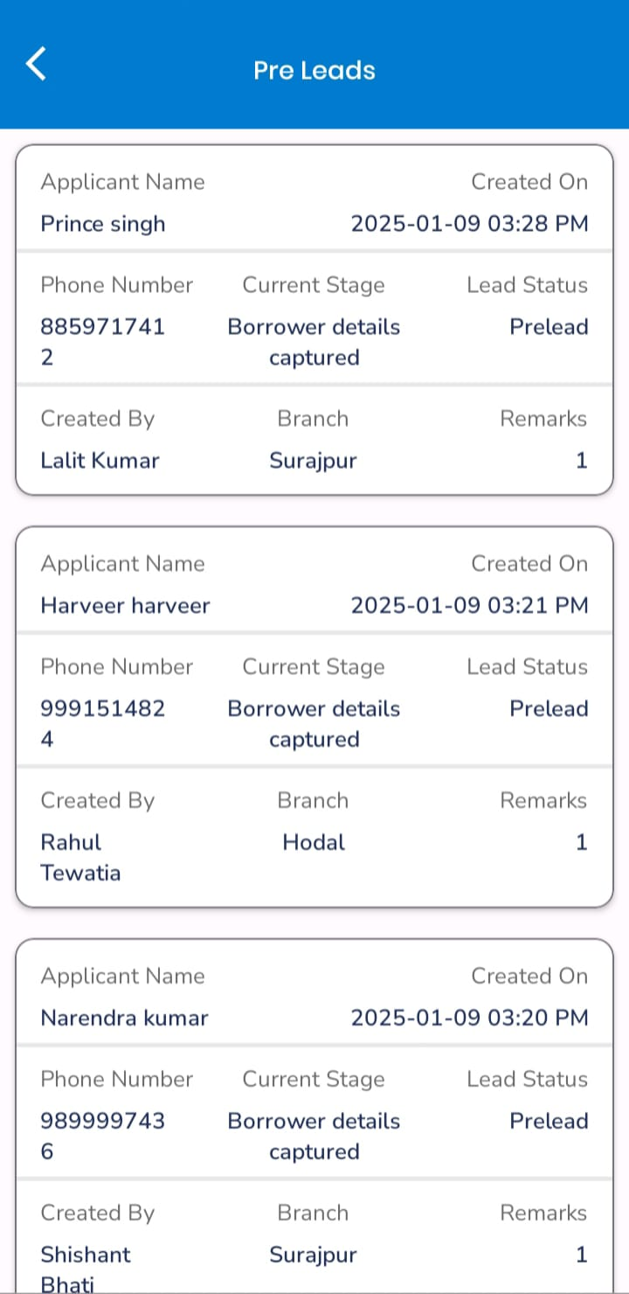
Follow up and Pre-Lead
Follow-Up Leads:
When a customer is interested, and the RM specifies a follow-up date for that lead, it is moved to the Follow-Up Leads section.
In this section, the RM can view all leads scheduled for follow-up on a specific date.
Pre-Leads:
Pre-Leads include all leads that have the potential to become full leads.
These may include:
  Partially Filled Leads: Leads where some required information is incomplete.
  Follow-Up Leads: Leads that may eventually be categorized as Green, Amber, or Red based on further evaluation.

